Slide 1
Project — Library Inquiry System
CSCI3170 Tutorial 2
Lixin Liu

Slide 2
Objective
You are required to implement a Library Inquiry System as a Java Command-line Program, which should achieve the following purposes:
Initialize the database, and then load data into the database.
Help the library user search books and show his/her own check-out records.
Help the librarian borrow and return a book copy
Help the library director find out un-returned book copies

Slide 3
Milestones
This project is divided into two phases:
Phase 1 — Database Management System
Design the database for the system, including the ER-diagram and relational schema.
You are required to use the suggested solution to complete phase 2.
Phase 2 — Java Command-line Program
Implement the Library Inquiry System as a Java Command-line Program.
Tutorials will be given about Java and MySQL later.

Slide 4
Data File
You will be given a file directory, under which there are four files:
Category – category.txt
Library Users – user.txt
Books – book.txt
Checked-Out Records - check_out.txt
Data Format
For each file:
Each line corresponds to an entry.
Each line ends with a \n character.
Attributes of each data entry (line) are delimited by a tab(\t) character.

Slide 5
Input File 1 – category.txt
Each category has a unique category id and it can be used to identify a category.

Slide 6
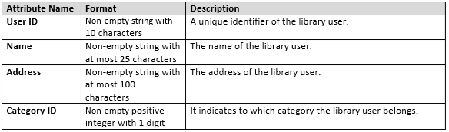
Input File 2 – user.txt
Each library user has a unique user ID and it can be used to identify a library user.
A user can only belong to one category.

Slide 7
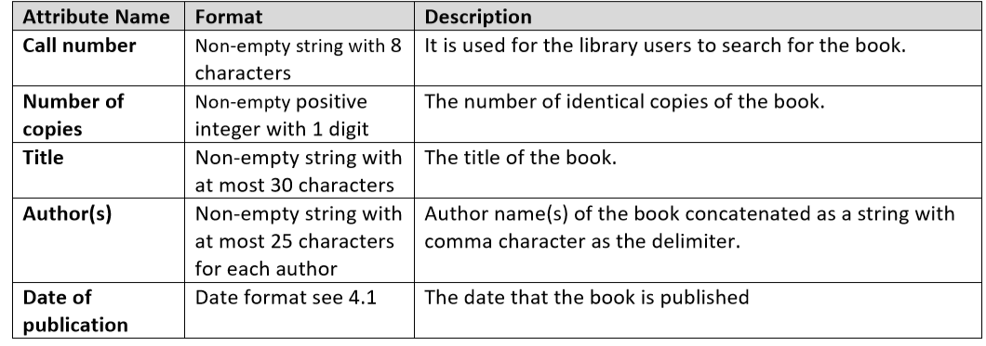
Input File 3 – book.txt
Each book has a unique call number and it can be used to identify a book.
Each book copy of a book has a copy number. If a book has n book copies, the copy number of those n book copies ranges from 1 to n.
For example, if a book has four copies, these four book copies have the same call number, and their copy numbers are 1, 2, 3 and 4.
Each book copy has a unique pair of call number and copy number and they can be used jointly to identify a book copy.

Slide 8
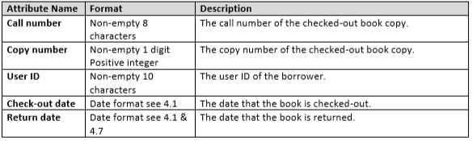
Input File 4 – check_out.txt
All dates follow the format “DD/MM/YYYY”, e.g. “16/09/2019”.
Some library users may have never checked out any book copies.
Some book copies may have never been checked out.
A user may borrow the same book copy for more than one time.
The return date of a book copy is NULL if the book copy is not returned.

Slide 9
Assumptions on the data and input
All numerical values will not be larger than the maximum integer value that can be handled by Java.
The system is case sensitive.
All dates follow the format “DD/MM/YYYY”, e.g. “16/09/2019”.
There is no duplicate row in any input files.
All user inputs are correct in format only.
Every input file is correct in format and content.

Slide 10
System Function Requirements
Your system should be a Java Command-line Program.
After performing a function, it should display the last appeared menu.
Your program should provide an interactive interface to:
Administrator
Library User
Librarian
Library director
answer their queries correctly and quickly, or handle errors properly.

Slide 11
Administrator
Your system should allow a database administrator to perform the following operations:
Create tables
Delete tables
Load data under a given data folder
Show the number of records in each table

Slide 12
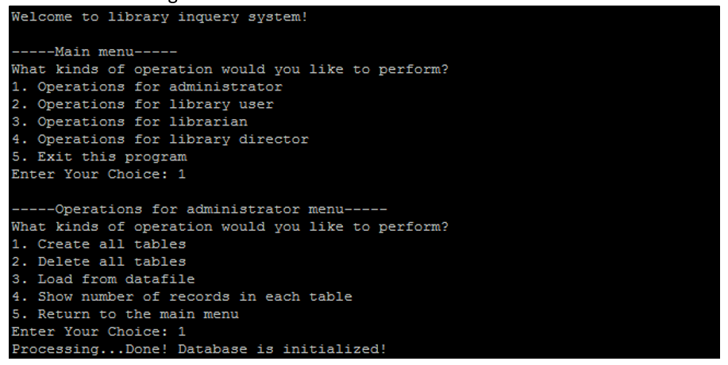
Example 1 (Create tables)

Slide 13
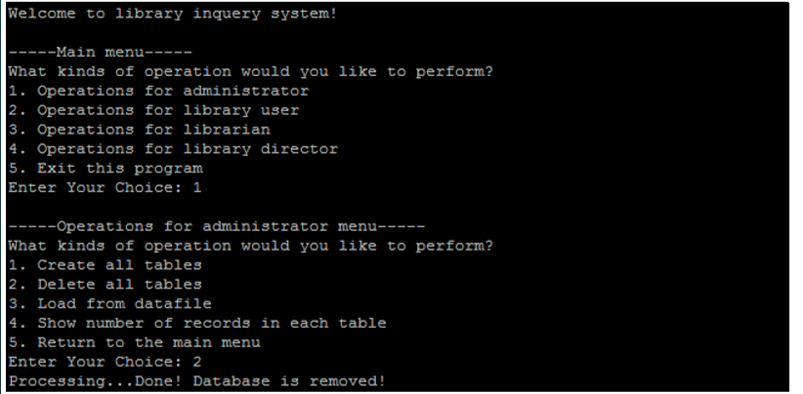
Example 2 (Delete tables)

Slide 14
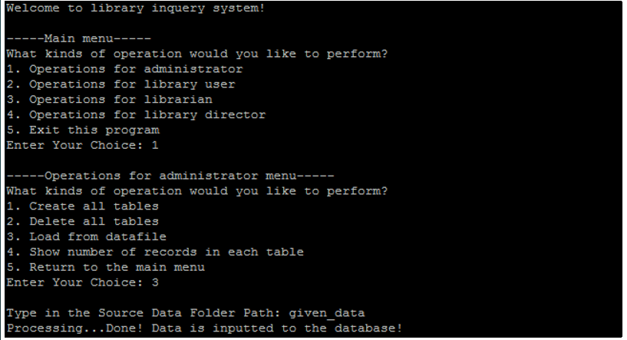
Example 3 (Load data under a given data folder)

Slide 15
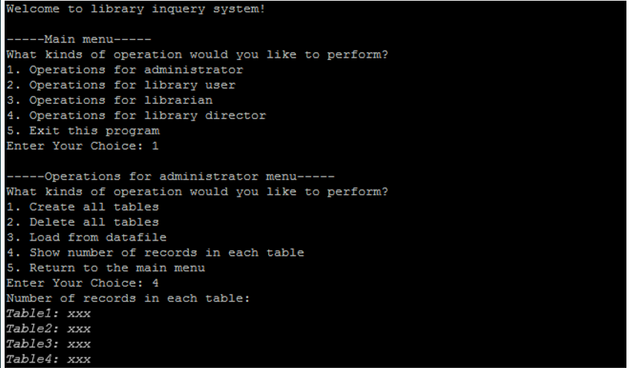
Example 4 (Show number of records in each table）

Slide 16
Library User
Your system should help the library user on the following operations:
Search for books
Show all check-out records of a library user:

Slide 17
Search for books
The system has to provide an interface to allow a library user to search for the books in the library in three different ways
By call number (exact matching)
By title (partial matching)
By author (partial matching)
Note: the program should perform the query and return all matching books in terms of their call number, title, authors and number of available copies. The results of the query should be sorted in ascending order of call number.

Slide 18
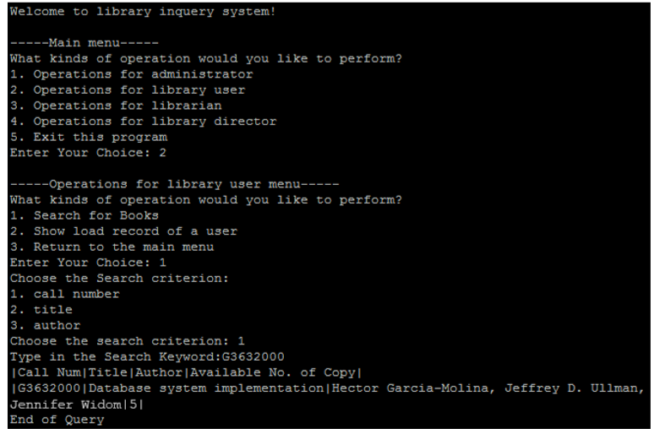
Example 5 (Search for books)

Slide 19
Show all check-out records of a library user
The system has to provide an interface to allow a library user to show all his/her check-out records of with a given user ID.
Note: the program will perform the query and return all the matching check-out records in terms of call number, copy number, title, authors, check out date and whether the book copy of the corresponding check-out record is returned. The check-out records should be sorted in descending order of check-out date.

Slide 20
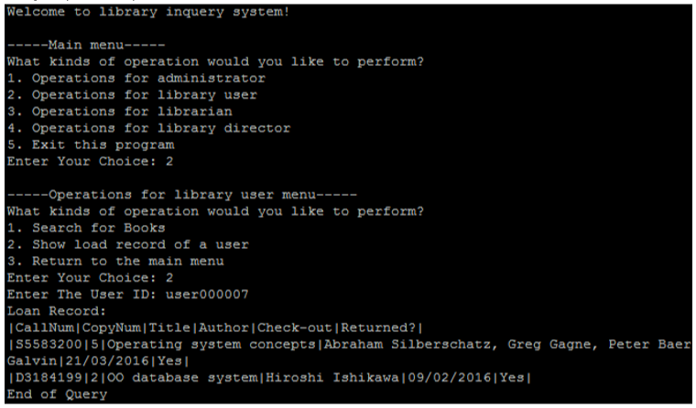
Example 6 (Show all check-out records of a user)

Slide 21
Librarian
Your system should help the librarian on the following operations:
Borrow a book copy
Return a book copy

Slide 22
Borrow a book copy
A librarian can perform the book borrowing procedure through the Library Inquiry System.
Input: call number and copy number of the book copy being borrowed and the user ID of the library user.
If the book copy is available, it is then borrowed and a new check-out record of the specified book copy and user with NULL return date should be added to the database accordingly.
There should be an informative message whether the book copy can be lent successfully in layman terms.

Slide 23
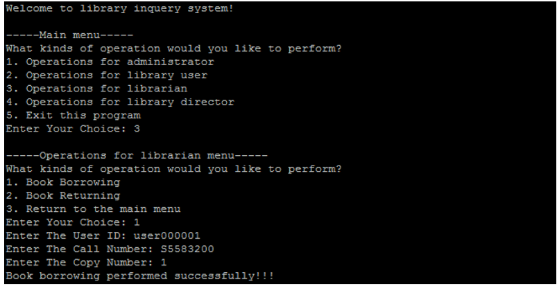
Example 7 (Borrow a book copy)

Slide 24
Return a book copy
A librarian can perform the book returning procedure through the Library Inquiry System.
Input: call number and copy number of the book copy being borrowed and the user ID of the library user.
Then the system should check if a check-out record corresponding to the specified user ID, call number and copy number exists.
If such record is found, the book copy can be returned, and the return date of the check-out record found is updated to be the current date of the database server. Finally, there should be an informative message whether the book copy can be returned successfully in layman terms.

Slide 25
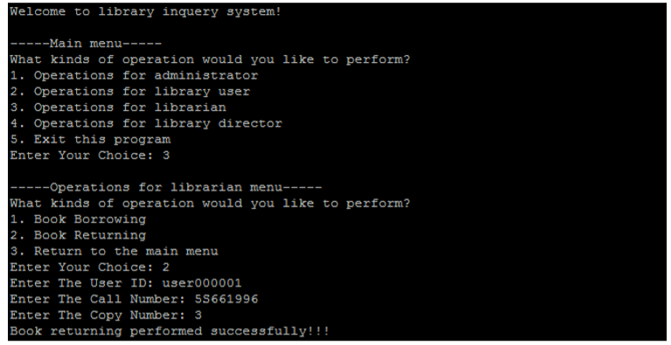
Example 8 (Return a book copy)

Slide 26
Library Director
Your system should help the library director on the following operations:
List all un-returned book copies which are checked-out within a period
Input: a period (e.g. from 16/08/2019 to 15/09/2019)
The program will perform the query and return a list of all overdue book copies in terms of user ID, call number, copy number and check-out date in descending order of check-out date within the inputted period inclusively.

Slide 27
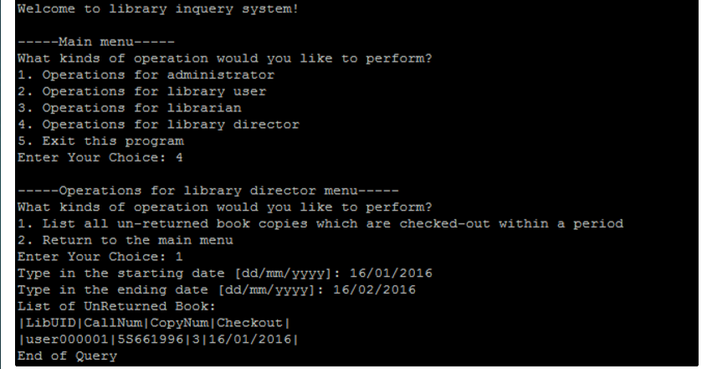
Example 9 (List all un-returned book copies which are checked-out within a period)

Slide 28
Error Handling
If a run-time error occurs, the Library Inquiry System should output an information message in layman terms and in a new line as shown below. You are not required to handle all possible errors, just try some.

Slide 29
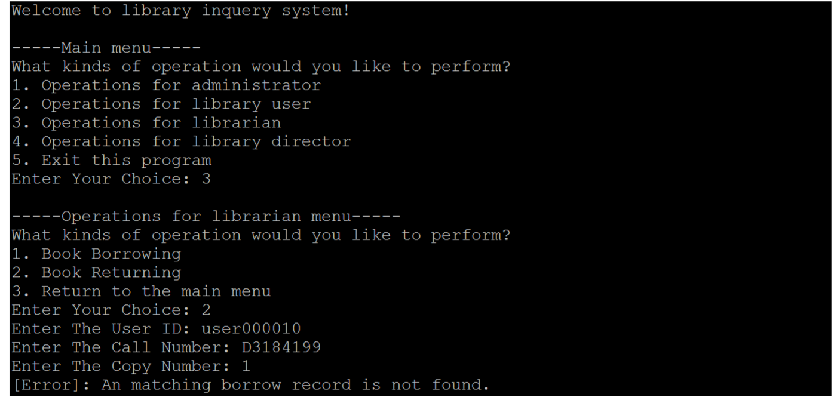
Example 10 (Error Handling)

Slide 30
Schedule
The schedule of this project is set as follows:
Preparation
Read the project specification.
Group Formation (Due: 23:59 29th Sept)
Register on Blackboard System, at most 3 members for each group
Phase 1 (Due: 23:59 13th Oct)
ER-diagram and relational schema.
Phase 2 (Due: 23:59 24th Nov)
Java application.
Presentation (To Be Advised)
Live demonstration.

Slide 31
For more details, such as grading policy, demonstration requirements and submission methods, etc. please refer to the document for project specification.
You are very much encouraged to read thoroughly and carefully all details in that specification and make sure to understand all tasks and requirements.
You are also welcomed to raise any question or issue to our tutors.

